Slide 1
ENABLE Visit
Richard Hamer
Head of Data & Innovation

Slide 2
The aim
Support the improved delivery of care and support at home through the use of technology that ultimately enables better digital access and inclusion for people using our services.
Our objective
Build a more user-friendly and up-to-date rota for the people we support showing who will be providing support and when

Slide 3
The problem
A variety of methods including post, hand delivery, telephone calls, texts or emails used to share rota information
Variety of styles and quality, some better than others, outputs from workforce management system particularly poor
Time consuming to produce, only accurate on the day they are made
Strong desire within service teams - given history and focus on learning disability - to provide more accessible information

Slide 4
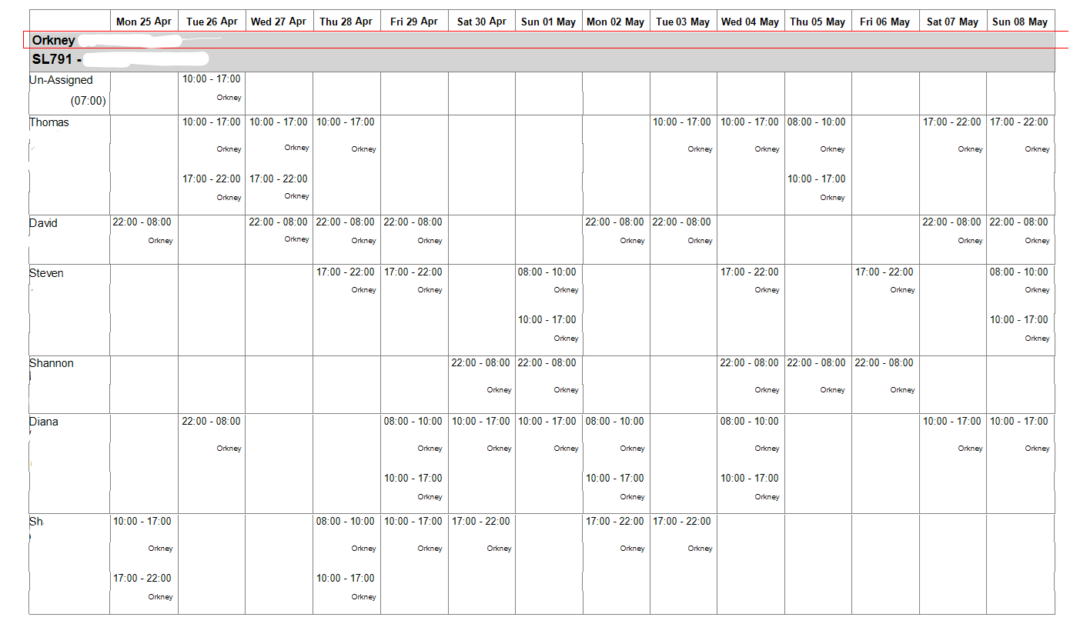

Slide 5
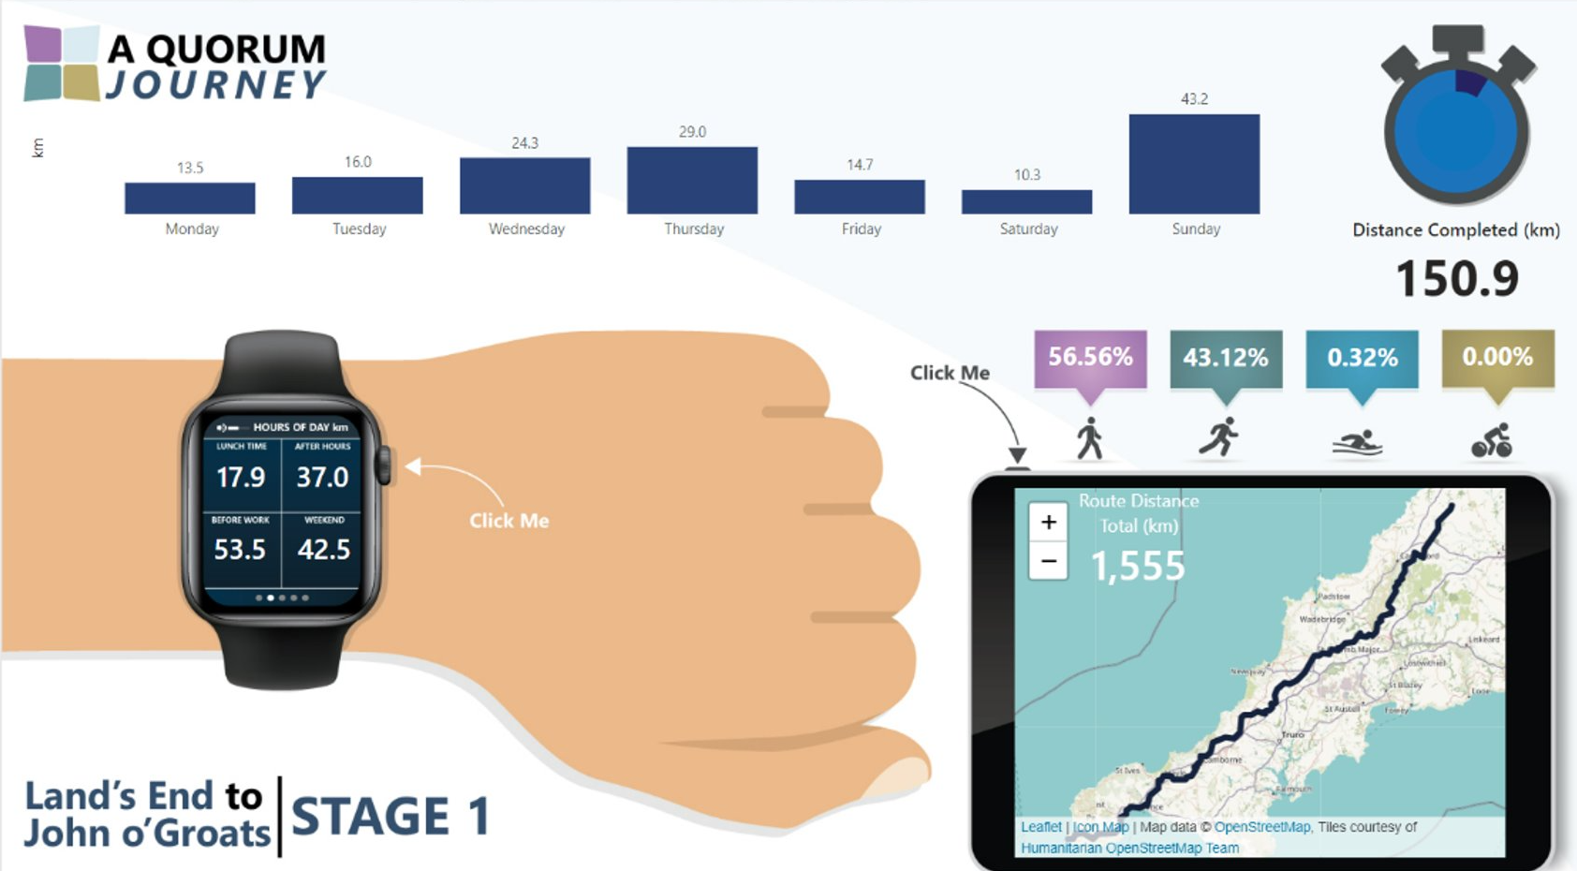

Slide 6
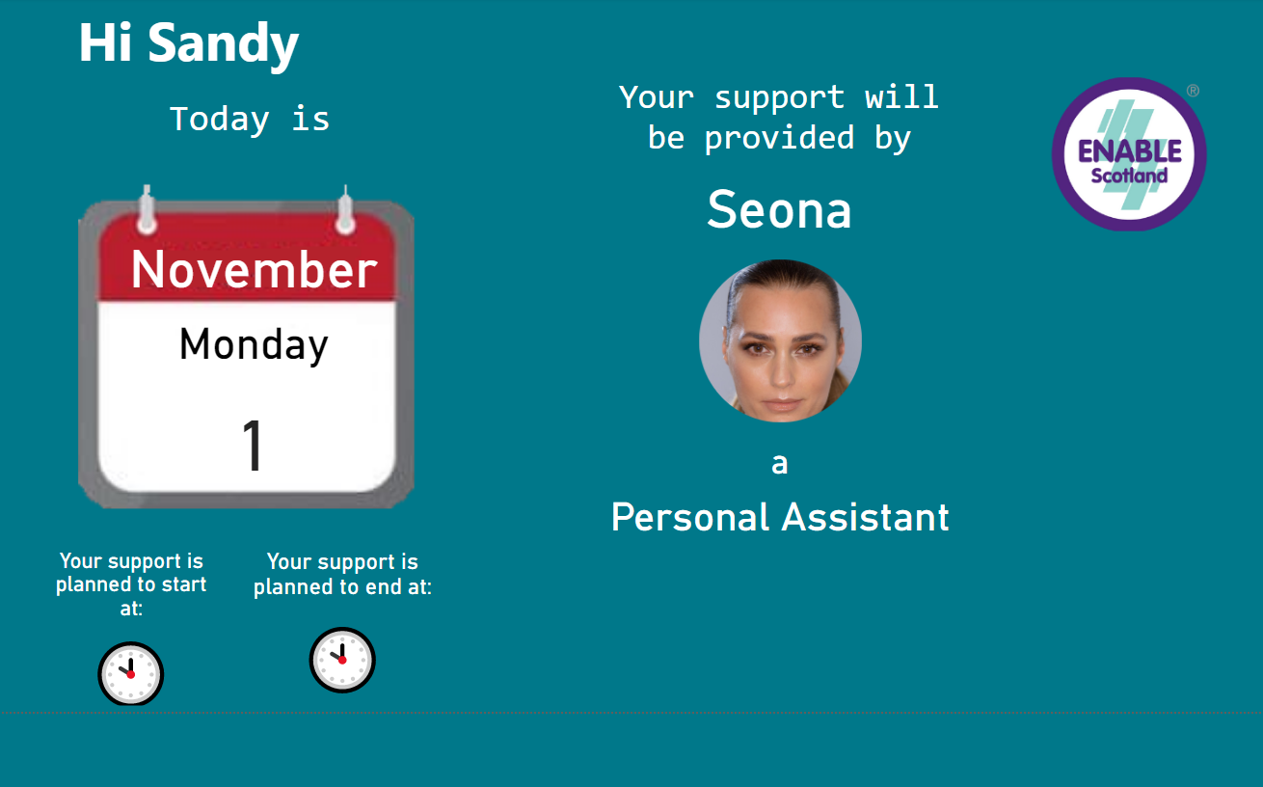

Slide 7
Proposed Test of Change
Test, in Orkney with 13 people we support, providing more accessible rota information digitally
Replace / run in parallel alongside existing ad hoc methods
Automatically create accessible rota information, using shift information from our workforce management application (rota system)
Provide tablets on which the rotas can be viewed
Establish how well different channels and devices perform

Slide 8
The techy bit
Shifts scheduled by staff on WFM application
Rota info collected by DataVault
Limited dataset of info sent to PoC database
Dataflow extracts data from PoC database to
ScottishGovtPOC [DF]
Dataset created in ScottishGovtPOC [DS]
Rota created in ScottishGovtPOC
Staff photos stored in DataVault
Required photos sent to PoC database
User email stored in PoC database

Slide 9
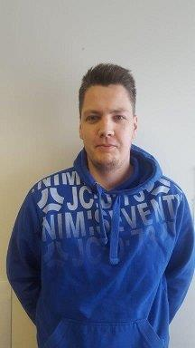
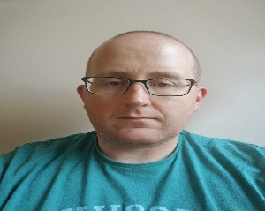
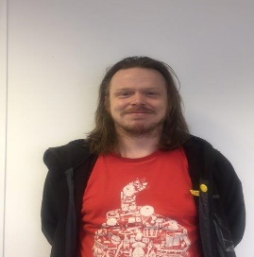
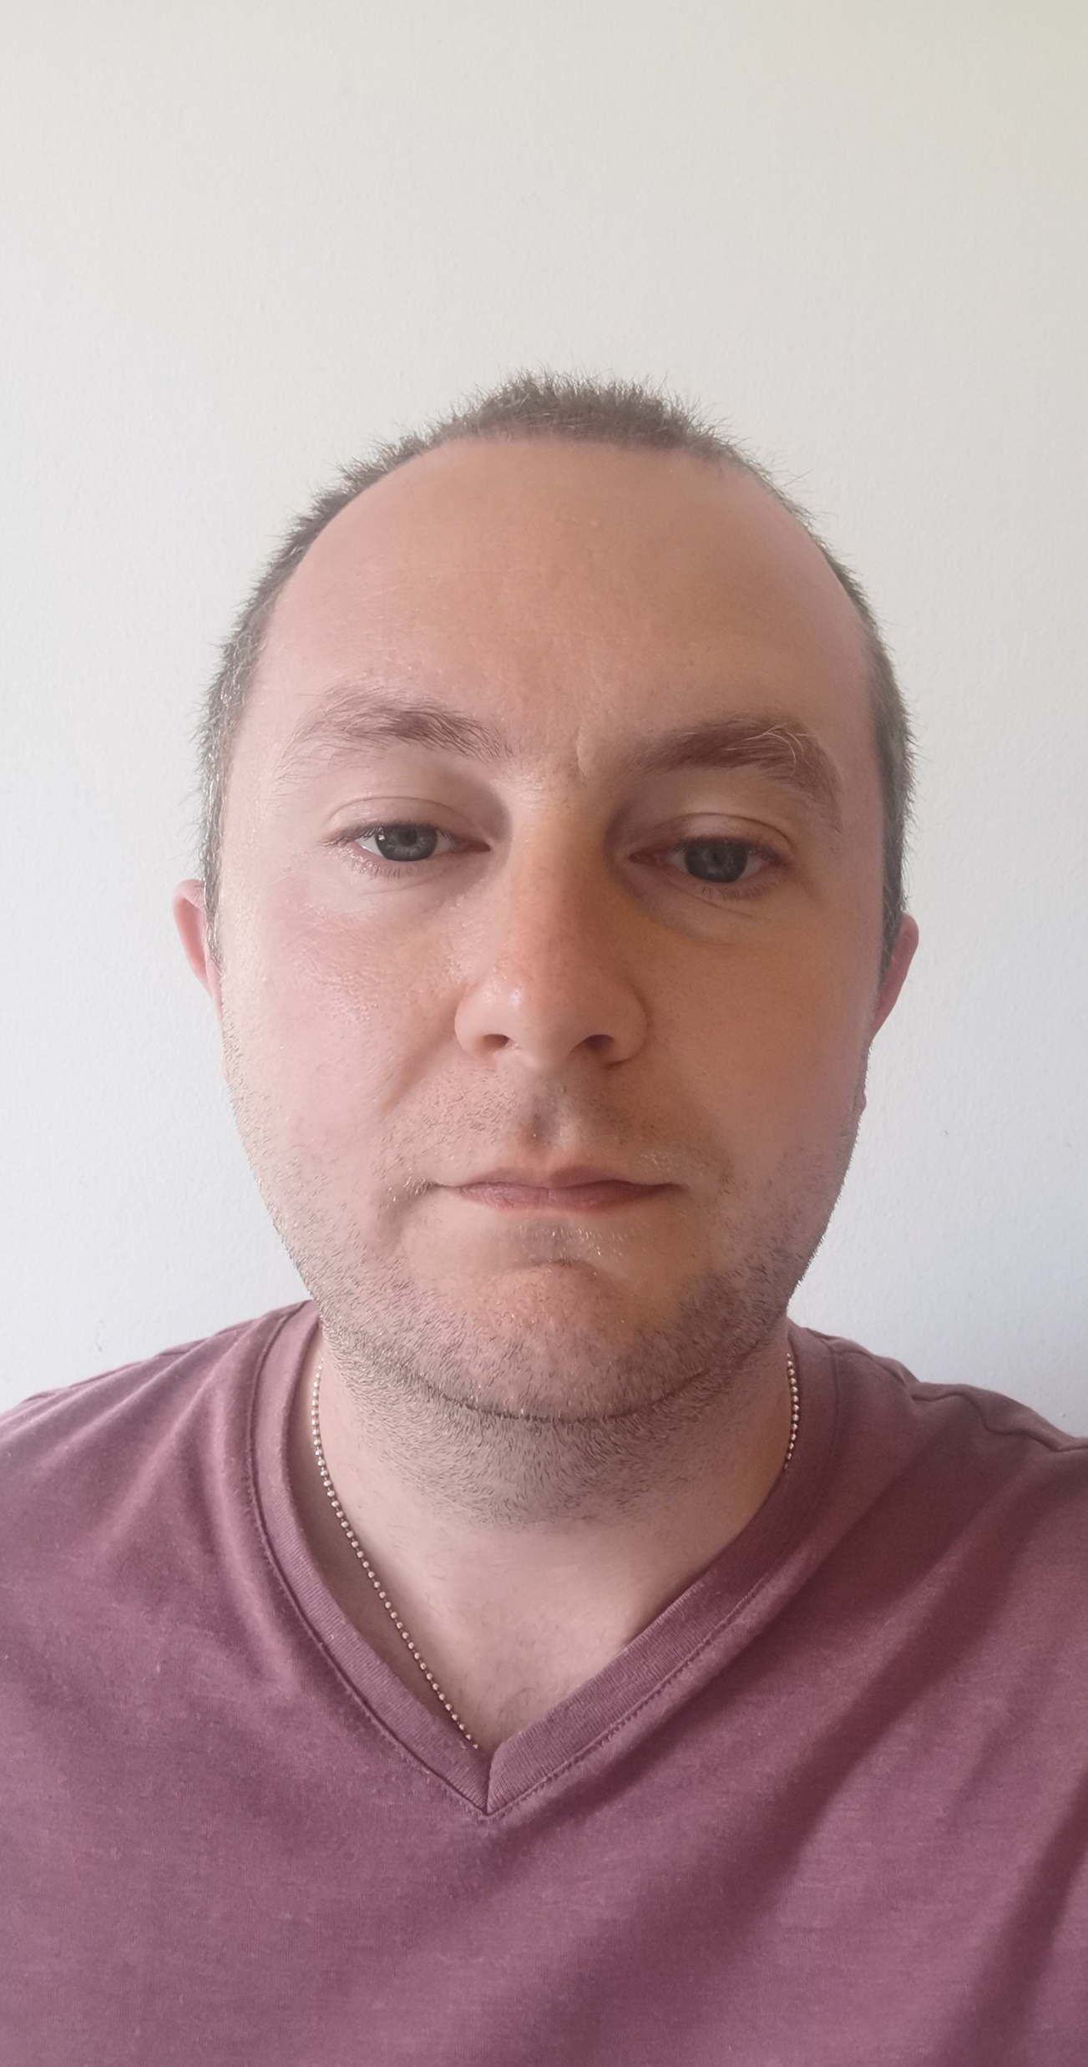
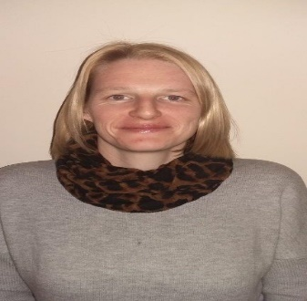
Name – Craig Simpson
Rota Starting – 18 January 2021
Week 3
 | Monday | Tuesday | Wednesday | Thursday | Friday | Saturday | Sunday
Morning
Day
Evening
Sleepover

Slide 10
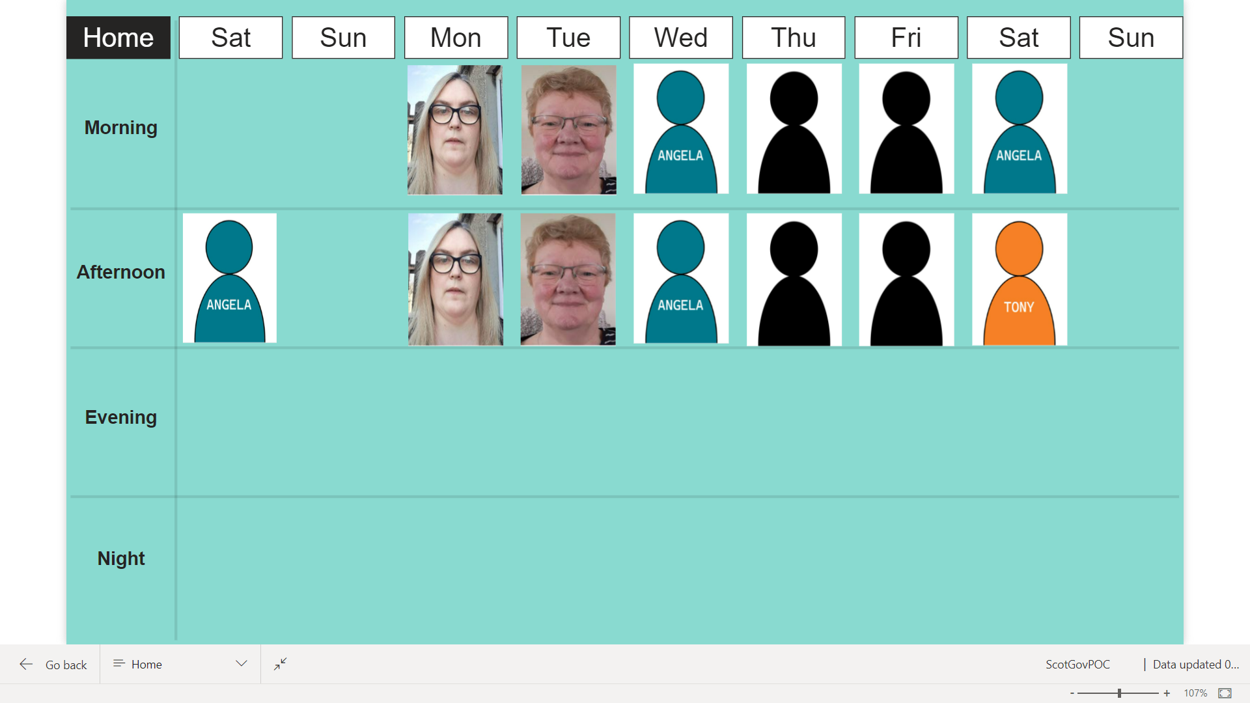

Slide 11
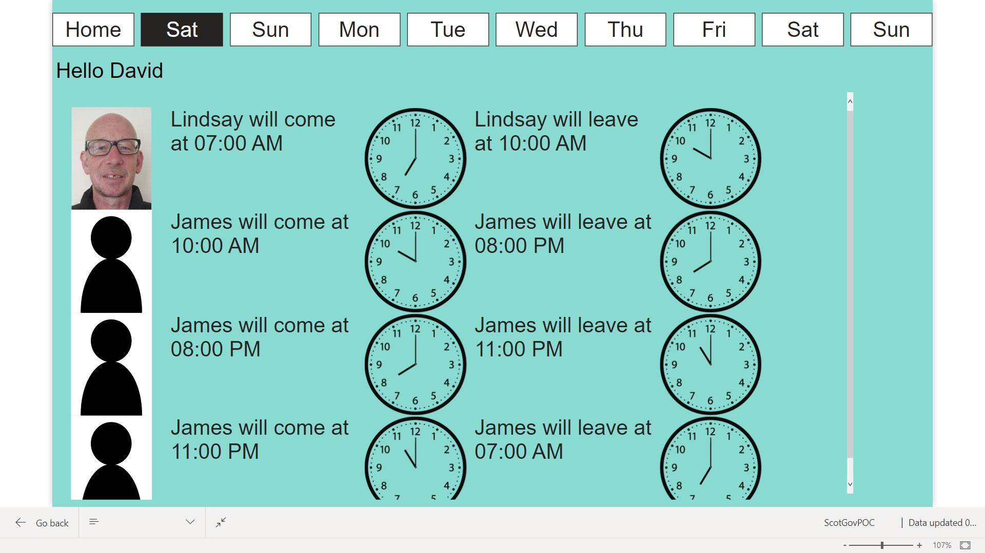

Slide 12
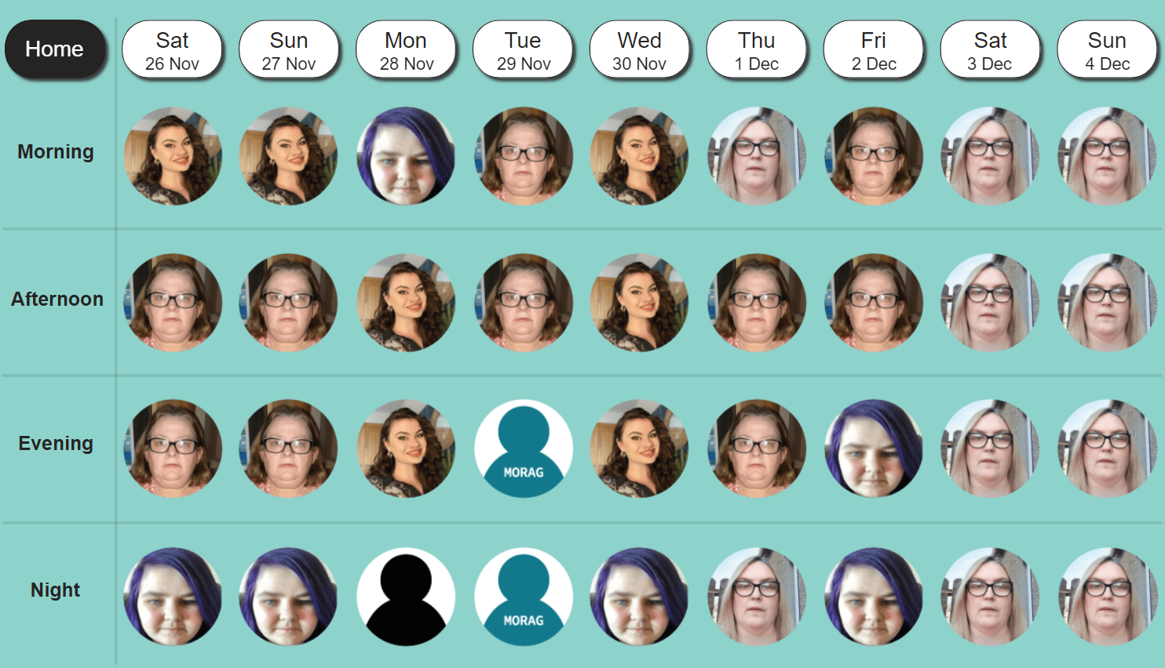

Slide 13
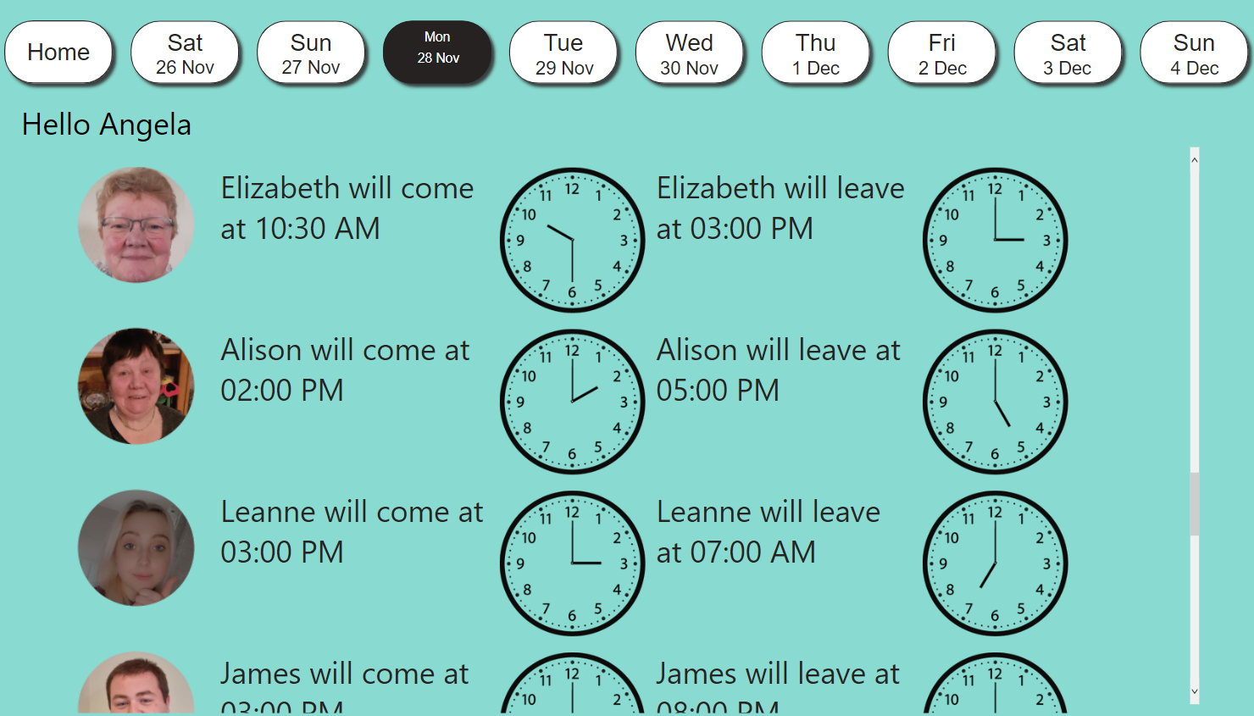

Slide 14
Our learning re the objective
The people we support and, unexpectedly our staff team, saw value in the digital rota design
Users didn’t highlight the benefits of up-to-date information
The tablets were essential for the programme but under-used
A targeted approach to providing the tablets and rotas would be most effective

Slide 15
Our learning re the approach
Using an off the shelf application - Power BI – means the project can easily be scaled/adopted by others
Digital solutions are complex and have significant data security and reliability implications
Human factors also cause challenges – photos, COVID, entrenched views
Digital rotas are one use for tablets – maximising the use of tablets is a programme in itself

Slide 16
Feedback
“it was handy to see so I could check who was coming in”
“the rota tablet was a great idea and a good option for the people we support.
“A lot of people we support all like to know who will be supporting them that day. It created some independence for the people we support to find out information on their own rather than asking a member of their team.”

