Slide 1
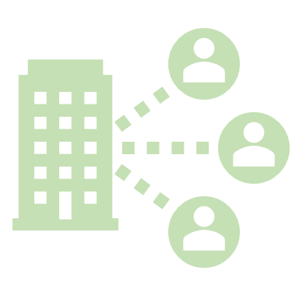
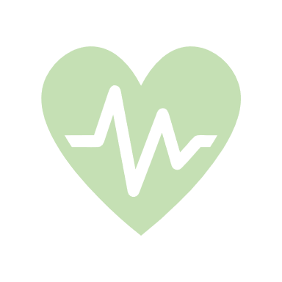
Digital Home Blood Pressure Monitoring
at 30 September 2023
14 Health Boards
What did people think?
96%
Liked it
60% GP Practices
29%
97%
Found it easy/ok to use
Of Adults in Scotland have high blood pressure (Scottish Govt)
84,674 total recruitment
93%
Would use it again
50%
28,870 in past 12 months
Of all Strokes and Heart Attacks are caused by high blood pressure (BHF)
Impact:
For every 50,000
Over 300,000
Appointments saved
People who routinely monitor BP, up to 745 strokes and 500 heart attacks could be avoided over a 5 year period
£12m saved
Cost effect over 10 years
(British Heart Foundation)
Avoided
appointments
Reduced Travel
Convenient and saves time
Reduced Infection Risk
Improved access to services
More accurate readings to aid clinical decisions
“more patients are taking responsibility for their own health and wellbeing” ​
(Michael et al (2019), 2017/18 costs)
Data Sources: Florence (self-reported by Health Boards, Inhealthcare, Connect Me standard patient survey, Scale-UP BP evaluation

Slide 2
Blood Pressure (Primary Care) Pathway
Notes:
Activation is an ‘episode of monitoring’ – one person could have multiple episodes of remote monitoring
Total on IHC pathway – 8525
1831 for June 23 – increase of 30% on May recruitment
35% of GP practices in Scotland now have access to the pathway (319 practices)

